Slide 1
Night and Day

Slide 2
The Earth Spins
How do people around the world experience Day and Night?
Notes:
Warm-Up
Time: 5 minutes
Objective: Students understand that the Earth spins on its axis within the orbit of the sun.
Procedures: Explain or elicit that the Earth is tilted and spins (north and south pole). All stand up and look at the teacher and turn slowly trying to keep your eyes on the teacher - at a point you have to move your head and you can not see the teacher for a time. Use this as an example of the earth spinning and there are times that certain parts of the earth can not see the sun - when it is dark and night time. Introduce that this is why it is daytime in places like Australia when it is night-time for the UK and parts of the US

Slide 3
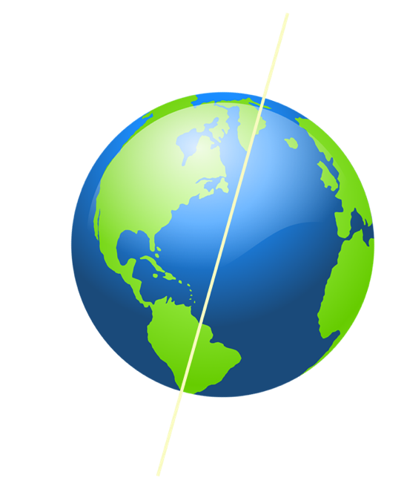
Mini-lesson
The Sun’s (apparent) movement
Notes:
Mini-lesson
Time: 7 minutes
Objective: Students develop understanding of the position of the Earth in relation to the Sun and the concept that the Earth spins and this effects the Sun we see on Earth.
Procedures: Where is the Sun during the day? Look at ( or make) a sundial and how the Sun shows the time. How does the Sun's position and shadow show the time? If it is a sunny day go out and stand with East on your left and West on your right. Work out position of your shadow and time it represents. http://www.liverpoolmuseums.org.uk/kids/games-quizzes/sun/suntracker.html this tracker allows students to change the date and location to see the motion of the sun.

Slide 4
Mini-lesson
The Sun’s (apparent) movement
Notes:
Mini-lesson
Time: 7 minutes
Objective: Students develop understanding of the position of the Earth in relation to the Sun and the concept that the Earth spins and this effects the sun we see on Earth.
Procedures: Where is the sun during the day? Look at a sundial and how the sun generates the time. How does the Sun's position and shadow show the time? If it is a sunny day go out and stand with East on your left and west on your right. Work out position of shadow and time it represents. http://www.liverpoolmuseums.org.uk/kids/games-quizzes/sun/suntracker.html this tracker allows students to change the date and location to see the motion of the sun.

Slide 5
Vocabulary
Match or define keywords in your workbook
Axis
Tilt
Sun
Earth
Notes:
Mini-lesson - Key Vocab
Time: 2 minutes
Procedures: Students match or define keywords in their workbooks.

Slide 6
Checks for understanding
Which of these is correct?
The Sun goes round the Earth
The Earth spins on its axis as it goes round the Sun
The Sun spins on its axis
In your workbooks or with a partner, record, discuss, or share how the earth spins on its axis and orbits the Sun. Explain how Day and Night happen.
Notes:
Checks for Understanding
Time: 1 minute
Note: the Sun actually does spin - about once every 27 days (on average because the Sun is made of gas and different parts spins at different speeds), but this does not explain what we experience on Earth.

Slide 7
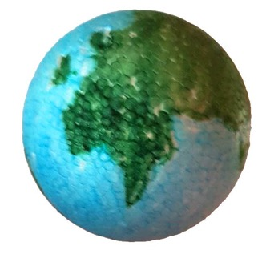
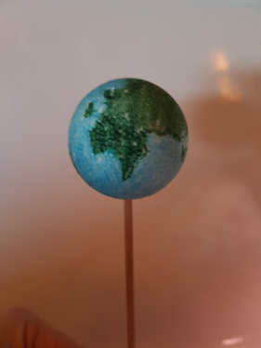
Worked Example
Step 1. Color a small styrofoam ball to represent the Earth.
Step 2. Using a wooden stick or pencil - place the ball so that the Earth is on a stick.
Notes:
Worked Example: Create a system to show day and night
Time: 8 minutes
Step 1. This could be a separate Art and Geography lesson. Students conduct an Internet search to find a globe pattern to mount on a paper mache (or other light but rigid material) ball and mount it on an axis. The structure should be light but rigid.
Step 2. If students have used another material for the ball other than polystyrene, they may have to use glue or plasticine to attach the Earth to the top of the stick.The axis can traverse the Earth if this makes things more robust

Slide 8
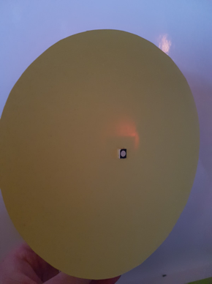
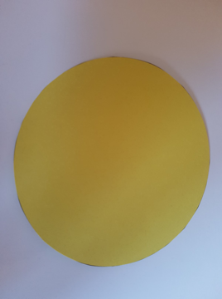
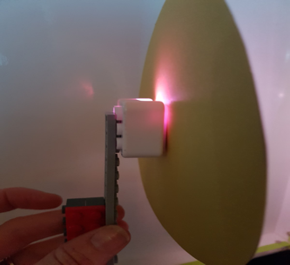
Worked Example
Step 3. Cut out a circle on yellow cardstock and pierce the middle. The RGB LED will be placed through the hole.
Step 4. Mount the RGB LED onto Lego to make the ‘sun’ free standing.
Notes:
Worked Example: Create a system to show day and night
Time: 8 minutes
Step 3. The yellow circle is a 2D representation of the Sun
Step 4. We will use this model to represent the Sun . Mention that the Sun is much bigger than the earth and this is why we have hade our circle so big.
Math/Science: calculate the size we would actually have to make our circle based on the size of our Earth, if we wanted to make everything to scale. Note: If we chose a 1/8 inch diameter circle to represent the Earth, we would require a circle bigger than one foot in diameter to represent the Sun

Slide 9
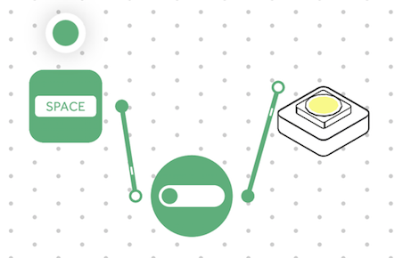
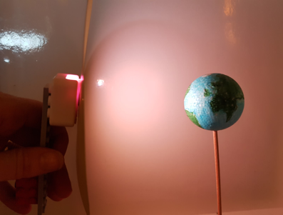
Worked Example
Step 5. Step 5. Turn on and pair: RGB LED Light Drag and connect a Key Press block and a Toggle block to the RGB LED.
Step 6. Hold the ‘sun’ a hands-length away from the sphere. Activate the system!
Notes:
Worked Example: Create a system to show day and night
Time: 8 minutes
Step 5. From the front, the 'sun' will be a large yellow disk emitting light. If you want to make this more realistic, use a paper lampshade. Students can be encourage to come up with other ideas to make a 'Sun'
Step 6. This will make the light from the 'Sun' constant without having to keep the Key Press depressed.

Slide 10
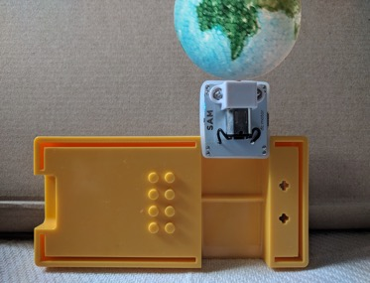
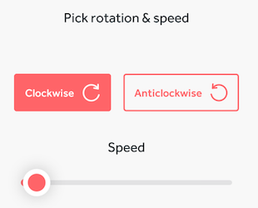
Challenge 1
Step 1. Mount the Earth on a motor
Step 2. Turn on and pair the DC Motor block. Drag the DC Motor block onto the Workspace. Open the motor Settings to make the motor as slow as possible without stopping.
Notes:
Challenge 1 - Make a working system that allows the Earth to revolve automatically
Time: 4 minutes
Step 1. The Motor axle will the the axis of our Earth
Step 2. It may be difficult to make the Earth spin slowly enough. It will certainly be impossible to make it revolve only once a day, as is in fact the case.
Step 3. Get suggestions from students as to how to make the Earth revolve more slowly

Slide 11
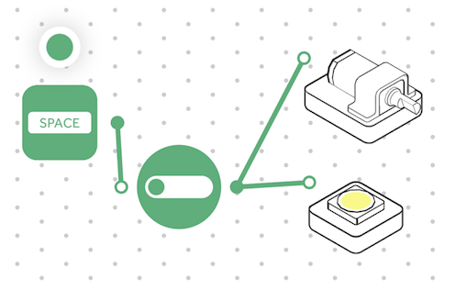
Challenge 1
Step 3. Connect the Toggle block to the DC Motor block.
Step 4. Start the Motor and switch on the light.
Notes:
Challenge 1 - Make a working system that allows the Earth to revolve automatically
Time: 4 minutes
Step 1. The Motor axle will the the axis of our Earth
Step 2. It may be difficult to make the Earth spin slowly enough. It will certainly be impossible to make it revolve only once a day, as is in fact the case.
Step 3. Get suggestions from students as to how to make the Earth revolve more slowly

Slide 12
Checks for understanding
1. The Motor imitates:
The orbit of the Earth around the Sun
The movement of the planets
The rotation of the earth on its axis
2. The Motor doesn’t imitate:
The orbit of the Earth around the Sun
The movement of the planets
The rotation of the Earth on its axis
Notes:
Checks for Understanding
Time: 1 minute

Slide 13
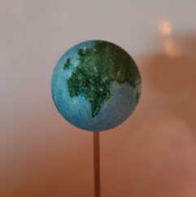
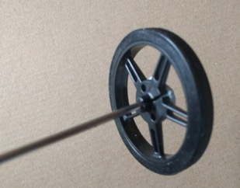
Challenge 1- Debug it!
Is the motor too fast?
Should the stick (axis) be vertical?
Let’s emulate Summer at the South Pole
Step 1. Mount the Earth on the stick again
Step 2. Mount a wheel on the stick
Notes:
Challenge 1 - Debug it: Mount the wheel on a longer axis in order to tilt the Earth and better see the effect of the tilt.
Time: 6 minutes
Step 1. T says… Mounting the Earth directly on the motor doesn't allow us to see the effect of the sunlight properly. It is better to mount the Earth on a stick and mount this to the motor. Mount the Earth on the stick again
Step 2. The stick should fit in the hole in the centre of the wheel
Step 3. T says… The added weight of the two wheels should help slow down the entire system. Not enough, but somewhat

Slide 14
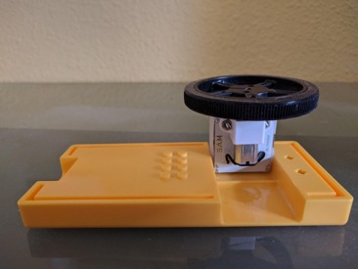
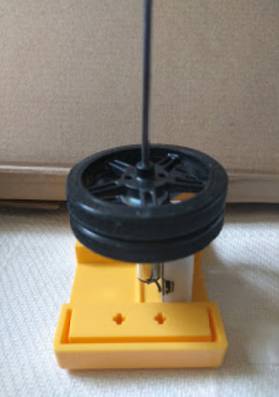
Challenge 1- Debug it!
Step 3. Mount another wheel on the Motor.
Step 4. Stick the two wheels together.
Notes:
Challenge 1 - Debug it: Mount the wheel on a longer axis in order to tilt the Earth and better see the effect of the tilt.
Time: 6 minutes
Step 4. T says... Now we have a rotating motorised Earth on a stick and we can see the effect of the sunlight properly.
Blue tack or plasticine are the easiest way to connect the two wheels
Step 5. Students may need help, depending on the protractor they use, to deduct 23º from 90º
Step 6. T says... The inclination of the Earth's axis is the reason we have seasons, As the earth orbits the sun, the northern and then the Southern hemisphere receive longer periods of daylight. If the axis were vertical then days would always be 12 hours long everywhere.
Extension idea: the inclination of the Earth's axis is the reason we have seasons, As the earth orbits the Sun, the Northern and then the Southern hemispheres receive longer periods of daylight. If the axis were vertical then days would always be 12 hours long everywhere. See, for example, the Lahaina Noon phenomenon.

Slide 15
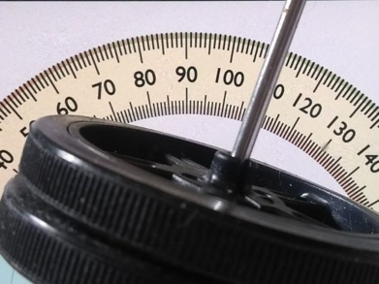
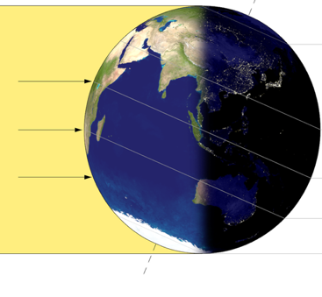
Challenge 1- Debug it!
Step 5. The Earth isn't completely upright. Incline it to about 23º.
Step 6. Now you can see that the South pole never gets dark when you rotate the Earth.
Notes:
Challenge 1 - Debug it: Mount the wheel on a longer axis in order to tilt the Earth and better see the effect of the tilt.
Time: 6 minutes
Step 4. T says... Now we have a rotating motorised Earth on a stick and we can see the effect of the sunlight properly.
Blue tack or plasticine are the easiest way to connect the two wheels
Step 5. Students may need help, depending on the protractor they use, to deduct 23º from 90º
Step 6. T says... The inclination of the Earth's axis is the reason we have seasons, As the earth orbits the sun, the northern and then the Southern hemisphere receive longer periods of daylight. If the axis were vertical then days would always be 12 hours long everywhere.
Extension idea: the inclination of the Earth's axis is the reason we have seasons, As the earth orbits the Sun, the Northern and then the Southern hemispheres receive longer periods of daylight. If the axis were vertical then days would always be 12 hours long everywhere. See, for example, the Lahaina Noon phenomenon.

Slide 16
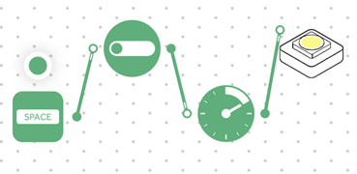
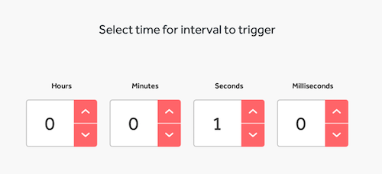
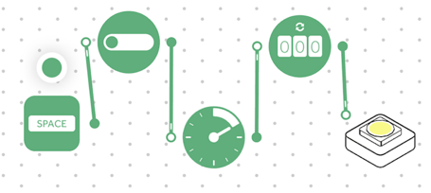
Challenge 2
Step 1. Go back to the solution to Challenge 1 and add an Interval block after the Toggle.
Step 2. Set the delay on the Interval block by selecting the settings and set it to 1 second.
Step 3. Add a Counter block and connect it to the output of the Interval block.
Notes:
Challenge 2 - Create a ‘sunrise’.
Time: 7 minutes
Step 1. T says... The Interval block is going to send a pulse to the counter in order to vary the brightness of the Light
Step 2. T says... The Interval block will send a pulse once every second
Step 3. T says... The Counter block will keep count of the pulses coming from the Interval block

Slide 17
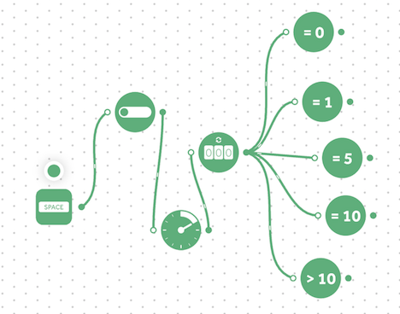
Challenge 2
Step 4. Add 5 x Compare blocks and connect all of them to the output of the Counter block and set them to: = 0 = 1 = 5 = 10 > 10
Notes:
Challenge 2 - Create a ‘sunrise’.
Time: 7 minutes
Step 4. T says... Each of the Compare blocks will send a signal when the Counter reaches the level set
Step 5. T says... The Invert block will switch the light:
On if it is off
Off if it is on
Step 6. When the Counter reaches:
1 the Cycle Brightness block will illuminate the Light at its lowest level
5 the Cycle Brightness block will illuminate the Light at its medium level
10 the Cycle Brightness block will illuminate the Light at its highest level

Slide 18
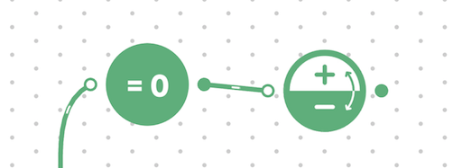
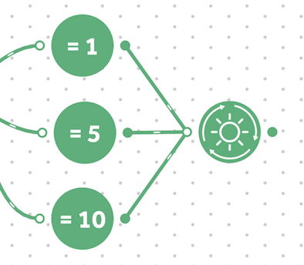
Challenge 2
Step 5. Add an Invert block and connect to the output of the Compare block with = 0 on.
Step 6. Add a Cycle Brightness block and connect to the output of the Compare blocks. Set them to =1, =5, =10.
Notes:
Challenge 2 - Create a ‘sunrise’.
Time: 7 minutes
Step 4. T says... Each of the Compare blocks will send a signal when the Counter reaches the level set
Step 5. T says... The Invert block will switch the light:
On if it is off
Off if it is on
Step 6. When the Counter reaches:
1 the Cycle Brightness block will illuminate the Light at its lowest level
5 the Cycle Brightness block will illuminate the Light at its medium level
10 the Cycle Brightness block will illuminate the Light at its highest level

Slide 19
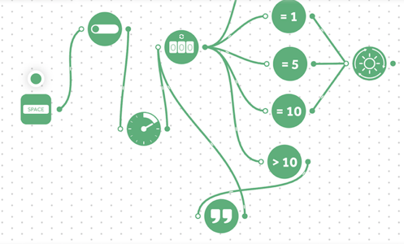
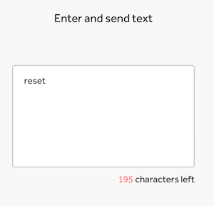
Challenge 2
Step 7. Add a Text block and connect the input to the output of the Compare block. Set the Compare block to ‘>10’ and the output of the Text block to the input of the Counter block. Set the text to ‘reset’ in the settings.
Notes:
Challenge 2 - Create a ‘sunrise’.
Time: 7 minutes
Step 7. T says... The Reset block will set the Counter to '0',
Step 8. T says... When the Counter is reset to ‘0' it will send a send a signal to the Invert block to switch the light on or off
Step 9. ELA: students at this stage should be able to write a short account of their experiment.

Slide 20
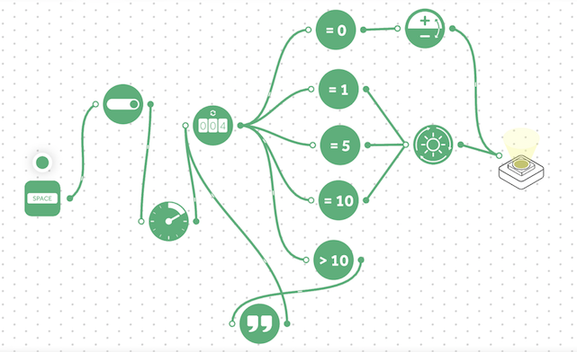
Challenge 2
Step 8. Connect the output of the Invert block to the Light. Connect the output of the Brightness block to the Light.
Step 9. Present your experiment!
Notes:
Challenge 2 - Create a ‘sunrise’.
Time: 7 minutes
Step 7. T says... The Reset block will set the Counter to '0',
Step 8. T says... When the Counter is reset to ‘0' it will send a send a signal to the Invert block to switch the light on or off
Step 9. ELA: students at this stage should be able to write a short account of their experiment.

Slide 21
Checks for understanding
If the North Pole never got dark… what might be happening?
The orbit of the Earth around the Sun is such that the North pole is inclined towards the Sun.
The speed of the Earth’s rotation
The position of Mercury
Notes:
Checks for Understanding
Time: 1 minute

Slide 22
Tidy Up/Exit Ticket
Today I learned….
Notes:
Tidy Up/Exit Ticket: Reinforcing the learning objectives of the lesson, students can reflect on key takeaways by completing and submitting an ‘exit ticket’.
Time: 1 minute

